Slide 1
Design and Analysis of Algorithms
Algorithms-II : CS345A
Lecture 6
Divide and Conquer Paradigm – V
The final Algorithm for Polynomial multiplication
Stable Matching Algorithm

Slide 2
Recap from Lecture 1

Slide 3

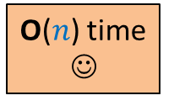

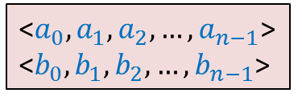
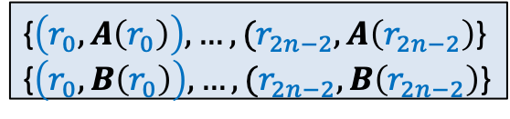
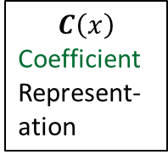


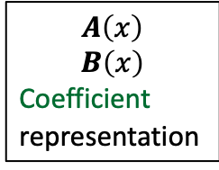

$C=A × B$
☹
$$C\left(x\right)$$
Coefficient
Represent-ation
$$A\left(x\right)$$
$$B\left(x\right)$$
Coefficient
representation
<$a_{0}, a_{1},a_{2},…,a_{n−1}$>
<$b_{0}, b_{1},b_{2},…,b_{n−1}$>
<$c_{0}, c_{1},c_{2},…,c_{2n−2}$>
O($n$ log $n$) time
O($n$ log $n$) time
Polynomial Evaluation
Polynomial Interpolation
{$\left(r_{0}, A\left(r_{0}\right)\right),…,(r_{2n−2}, A\left(r_{2n−2}\right)$}
{$\left(r_{0}, B\left(r_{0}\right)\right),…,(r_{2n−2}, B\left(r_{2n−2}\right)$}
{$\left(r_{0}, C\left(r_{0}\right)\right),…,(r_{2n−2}, C\left(r_{2n−2}\right)$}
O($n$) time
☺

Slide 4

Polynomial Evaluation Problem
Given a polynomial $A$ of degree less than $n$in coefficient representation,
Choose any set $S$ of $n$ numbers
Compute $A\left(v\right)$ for all $v∈S$.
Assumption:
$n$ is a power of 2.
In the last lecture, we discussed a divide and conquer based algorithm for polynomial evaluation. We were left with a question …

Slide 5
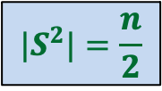



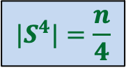
Question
Is it possible to select $S$ such that
…
$$|S^{2}|=\frac{n}{2}$$
$S$ = $\{2,3,9,−2,−3,−9\}$
$${|S}^{4}|=\frac{n}{4}$$
Good start !
But how to satisfy the remaining requirements …
$${|S}^{n}|=1$$

Slide 6
Complex numbers
Recalling elementary facts

Slide 7
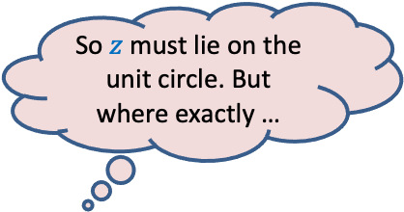

Complex roots of unity
Definition:
A number $z$ is said to be $n$th root of unity
if it satisfies equation.
$$z^{n}=1$$
$$z⋅z⋅z⋅ …⋅z=1$$
Magnitude($z$) = 1
Argument($z$) = ?
$$\{1, ω_{n} ,ω_{n}^{2},ω_{n}^{3},…,ω_{n}^{n−1}\}$$
Complex plane
$$\frac{2π}{n}$$
$$1$$
multiple of $\frac{2π}{n}$
$$R_{n}=$$
Unit circle
So $z$ must lie on the unit circle. But where exactly …
$n^{th}$Principal rool of unity

Slide 8

Complex roots of unity
$$R_{3}$$
What is $\left\{x^{2} \right|x∈R_{3}\}$ ?
$$R_{4}$$
What is $\left\{x^{2} \right|x∈R_{4}\}$ ?
$$ω_{4}^{1}$$
$$ω_{3}^{1}$$
$$ω_{3}^{3}$$
$$ω_{4}^{2}$$
$$ω_{4}^{4}$$
$$ω_{3}^{2}$$
$$ω_{4}^{3}$$
$$R_{3}$$
$$R_{2}$$

Slide 9
Complex roots of unity
Theorem:
If $n$ is odd $\left\{x^{2} \right|x∈R_{n}\}=R_{n}$
If $n$ is even $\left\{x^{2} \right|x∈R_{n}\}=$ $R_{\frac{n}{2}}$
Is it possible to select $S$ such that
…
?
$$S^{2}=\frac{n}{2}$$
$$S^{4}=\frac{n}{4}$$
$$S^{n}=1$$
$$S=R_{n}$$

Slide 10

The Recursion Tree
points
for
evaluation
$A\left(x\right)=$ $A_{even}$($x^{2}$) + $x A_{odd}$($x^{2}$)
degree
$$A$$
$$<n$$
$$R_{n}$$
T($n$) = Time complexity of Evaluating $A\left(x\right)$ on $R_{n}$
= a$n$ + $2$T($\frac{n}{2}$)
$$A_{even}$$
$$A_{odd}$$
$$<n/2$$
$$R_{\frac{n}{2}}$$
$$<n/4$$
$$R_{\frac{n}{4}}$$
$$<1$$
$$R_{1}$$
= O($n$ log $n$)

Slide 11
O($n^{2}$) time
☹
$$A\left(x\right)$$
$$B\left(x\right)$$
Coefficient
represntation
<$a_{0}, a_{1},a_{2},…,a_{n−1}$>
<$b_{0}, b_{1},b_{2},…,b_{n−1}$>
<$c_{0}, c_{1},c_{2},…,c_{2n−2}$>
O($n$ log $n$) time
Done
?
O($n$ log $n$) time
{$\left(r_{0}, A\left(r_{0}\right)\right),…,(r_{2n−2}, A\left(r_{2n−2}\right)$}
{$\left(r_{0}, B\left(r_{0}\right)\right),…,(r_{2n−2}, B\left(r_{2n−2}\right)$}
{$\left(r_{0}, C\left(r_{0}\right)\right),…,(r_{2n−2}, C\left(r_{2n−2}\right)$}
O($n$) time
☺

Slide 12
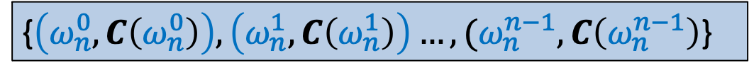

Interpolation
There is a polynomial
$$C\left(x\right)=c_{0}+c_{1}x+c_{2}x^{2}+ …c_{n−1}x^{n−1}$$
with $c_{j}$’s unknown.
Given the following (point, value) representation of $C\left(x\right)$:
Aim: To compute $c_{j}$’s .
{$\left(ω_{n}^{0}, C\left(ω_{n}^{0}\right)\right),\left(ω_{n}^{1}, C\left(ω_{n}^{1}\right)\right)…,(ω_{n}^{n−1}, C\left(ω_{n}^{n−1}\right)$}

Slide 13
Attention
Inspite of the best efforts by the instructor, majority of the class could not follow the next 5 slides for addressing the problem of interpolation.
The instructor has now revised these slides.
Important advice: Please go over these slides very very slowly.
If you still can’t internalize them, please meet the instructor.
He will be very grateful to you to know the difficulty you faced.

Slide 14

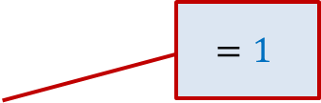

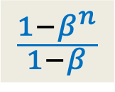


A Tool
$$\{1, ω_{n} ,ω_{n}^{2},ω_{n}^{3},…,ω_{n}^{n−1}\}$$
Question : = ?
If $β=1$,
Otherwise
$$β∈$$
$$=1$$
$$n$$
$$\sum_{0≤j<n}{{\left(β\right)}^{j} }$$
0
$$\frac{1−β^{n}}{1−β}$$

Slide 15
Interpolation
Polynomial Interpolation = Polynomial evaluation
Can you guess the polynomial whose evaluation will help solve polynomial interpolation ?
Make an obvious guess.

Slide 16


Interpolation
Solution:
Define a polynomial
$D\left(x\right)=d_{0}+d_{1}x+ …+d_{j}x^{j}+ …d_{n−1}x^{n−1}$, where $d_{j}=$ $C\left(ω_{n}^{j}\right)$.
Evaluate $D$ on $R_{n}$.
This will help us extract coefficient of $C$. ☺
What is $D\left(ω_{n}^{ℓ}\right)$ ?
Can you guess what is relation between $d_{j}$and $C$?

Slide 17



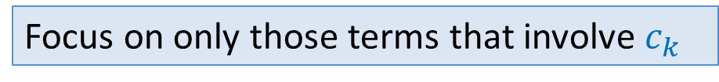
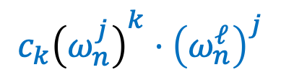

Interpolation
Solution:
Define a polynomial
$D\left(ω_{n}^{ℓ}\right)=d_{0}+d_{1}⋅ω_{n}^{ℓ}+ …+d_{j}⋅{\left(ω_{n}^{ℓ}\right)}^{j}+ …d_{n−1}⋅{(ω_{n}^{ℓ})}^{n−1}$
$$\sum_{0≤t<n}{c_{t}{\left(ω_{n}^{j}\right)}^{t}}$$
$$C\left(ω_{n}^{j}\right)$$
Focus on only those terms that involve $c_{k}$
$${c_{k}\left(ω_{n}^{j}\right)}^{k}⋅{\left(ω_{n}^{ℓ}\right)}^{j}$$
This expression has $n^{2}$terms.
It looks too complex.

Slide 18






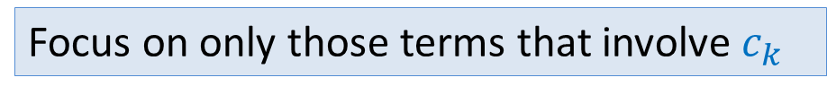









Interpolation
Solution:
Define a polynomial
$D\left(ω_{n}^{ℓ}\right)=d_{0}+d_{1}⋅ω_{n}^{ℓ}+ …+d_{j}⋅{\left(ω_{n}^{ℓ}\right)}^{j}+ …d_{n−1}⋅{(ω_{n}^{ℓ})}^{n−1}$
$$\sum_{0≤t<n}{c_{t}{\left(ω_{n}^{0}\right)}^{t}}$$
$$\sum_{0≤t<n}{c_{t}{\left(ω_{n}^{1}\right)}^{t}}$$
$$\sum_{0≤t<n}{c_{t}{\left(ω_{n}^{j}\right)}^{t}}$$
$$\sum_{0≤t<n}{c_{t}{\left(ω_{n}^{n−1}\right)}^{t}}$$
Focus on only those terms that involve $c_{k}$
$$c_{k}$$
$$c_{k}ω_{n}^{k+ℓ}$$
$${c_{k}\left(ω_{n}^{k+ℓ}\right)}^{j}$$
$${c_{k}\left(ω_{n}^{k+ℓ}\right)}^{n−1}$$
Tool
$$+$$
$$+…+$$
$$+…+$$
$=nc_{k}$
for $k=n−ℓ$
$$=0$$
for $k≠n−ℓ$

Slide 19
Homework
Write a neat pseudocode for Interpolation.

Slide 20
Optional Programming Assignment
Implement the algorithm.

Slide 21
Problem from Lecture 1
A Physics Problem

Slide 22



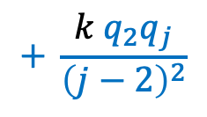
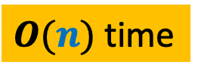



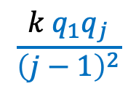
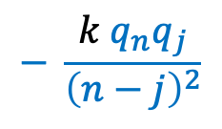

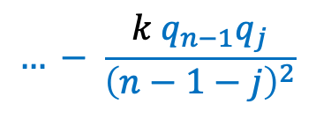
$$1$$
$$1$$
$$1$$
$⊕$ $⊕ ⊕…$ $⊕$ … $⊕$ $⊕$
$$q_{1} q_{2} q_{3} q_{j} q_{n−1} q_{n}$$
$F_{j}$ : Force exerted on $q_{j}$
Aim: Compute $F_{j}$ for each $1≤j≤n$
$$\frac{k{ q}_{1}q_{j}}{{\left(j−1\right)}^{2}}$$
$$+ \frac{k{ q}_{2}q_{j}}{{\left(j−2\right)}^{2}}$$
$$…+ \frac{k{ q}_{j−1}q_{j}}{{\left(1\right)}^{2}}$$
$$F_{j}=$$
$O(n)$time
$$− \frac{k{ q}_{j+1}q_{j}}{{\left(1\right)}^{2}}$$
$$… − \frac{k{ q}_{n−1}q_{j}}{{\left(n−1−j\right)}^{2}}$$
$$− \frac{k{ q}_{n}q_{j}}{{\left(n−j\right)}^{2}}$$
in $O(n log n)$time.
Attempt this problem now ☺

Slide 23
Stable Marriage Problem
An Algorithm

Slide 24

Stable Marriage Problem
$M$ : set of $n$men
$W$ : set of $n$women
For each man $m∈M$,
$L(m)$: a preference list of all women
For each woman $w∈W$,
$L(w)$: a preference list of all men
Aim: To compute a stable marriage.

Slide 25
Algorithm for Stable Marriage
1962, David Gale and Lloyd Shapley
Man proposes
God disposes
Woman

Slide 26
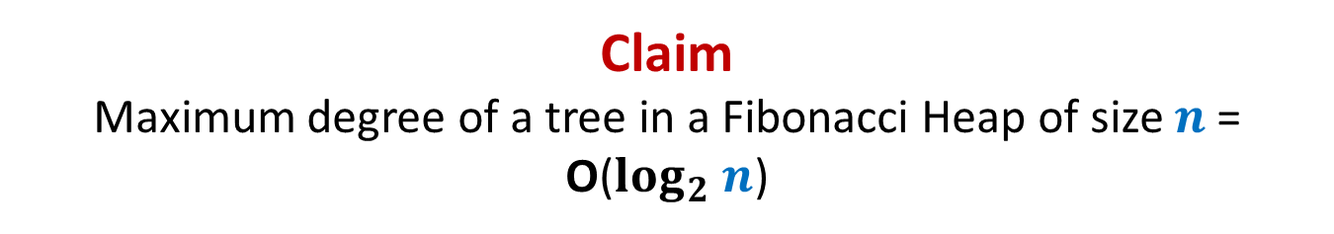













Stable Marriage Problem
Women
Men
$$w_{1}$$
$$m_{1}$$
$$2$$
$$w_{2}$$
$$m_{2}$$
$$1$$
$$w_{3}$$
$$m_{3}$$
$$1$$
$$1$$
$$w_{i}$$
$$m_{j}$$
$$w_{n}$$
$$m_{n}$$

Slide 27
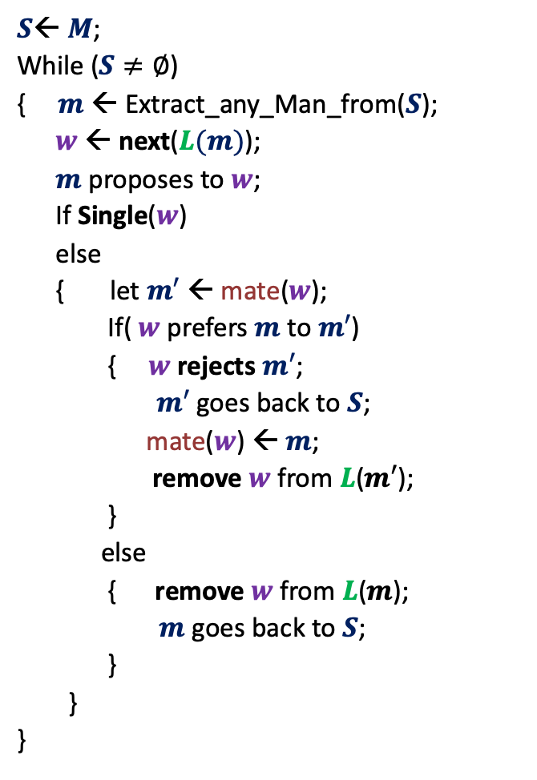



GaleShapley($M$, $W$)
$S$← $M$;
While ($S≠∅$)
{ $m$← Extract_any_Man_from($S$);
$w$ ← next($L(m)$);
$m$ proposes to $w$;
If Single($w$)
else
{ let $m′$ ← mate($w$);
If( $w$ prefers $m$ to $m′$)
{ $w$rejects $m′$;
$m′$ goes back to $S$;
mate($w$) ← $m$;
remove $w$from $L$($m′$);
}
else
{ remove $w$from $L$($m$);
$m$ goes back to $S$;
}
}
}
Question: Does the algorithm compute stable matching ?
Question: Does the algorithm even terminate ?
Homework:
Ponder over these questions.
mate($w$) ← $m$;
in list $L(w)$, $m$precedes $m′$)

